Slide 1
US Stocks Analysis
July 25, 2019
Team 3
Joanna Lee, Harmeet Kaur, Neda Iranmanesh,
Eric Koritko, Balakumar Janakiraman, Nitin Jain & David Klaassen

Slide 2
Table of Contents
Project Overview & Outline of Approach
Project Goals
a) Identify the fastest growing sector and the top 5 companies that drive the sector
b) Find the top 10 companies to invest in based on the following industry indicators. These indicators are commonly used by financial analysts across the globe.
Liquidity
Working Capital

Slide 3
Project Overview
Analyzed US stocks found on http://www.usfundamentals.com
About this data
12,129 companies
8,526 unique indicators
~20 indicators comparable across most companies
Yearly data

Slide 4
Outline of our Approach
Steps | Details
Data Inspection | Use relevant functions to help understand the data
Determining which parameters to consider | Determine how to calculate Growth of Sector Stability Volatility Assets
Data Cleaning | Merge two files Delete data with null values Drop all parameter not used
Calculating Sector Growth | Use Compound Annual Growth Rate (CAGR), Net Income, Total Assets to find the Growth Rate of a company Use weighted averages of all companies in a sector to find the sector’s Growth Rate
Finding top 5 companies driving the growth in the given sector | Determine top 5 companies based on their Compound Annual Growth Rates (CAGR)
Determining companies with given attributes | Calculated Current ratio, Working Capital, Assets to Liabilities, Debt to Equity, Treasury Share and Dividend Paid Per Share

Slide 5
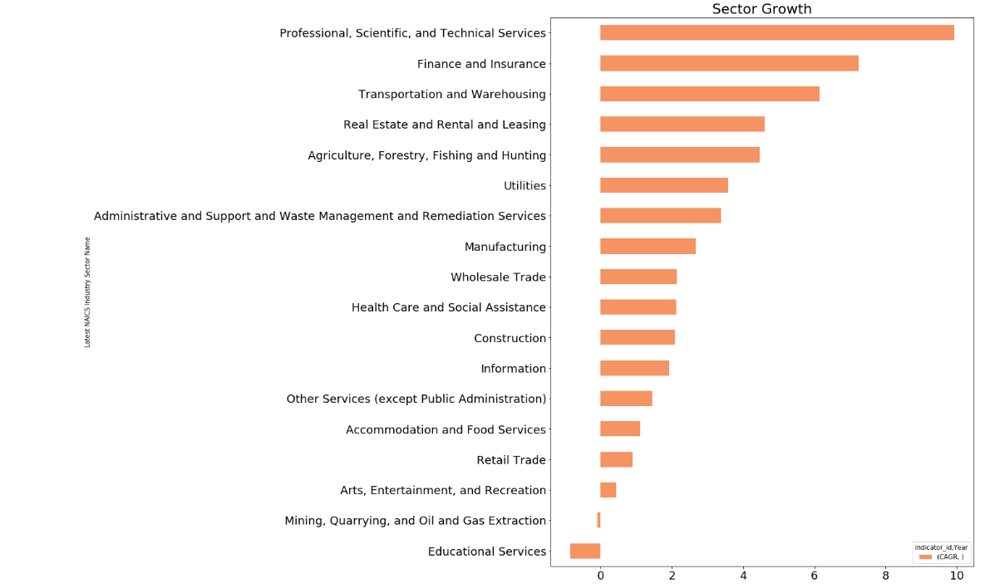
Identifying Trends of the Sector
Top 3 Sectors:
Professional, Scientific and Technical Services
Finance and Insurance
Transportation and Warehouse

Slide 6
Top 5 Companies that drive top Sector
Company Name | CAGR
Groupon, Inc. | 204.206935
Digipath,Inc. | 114.522004
Neogenomics Inc | 72.071256
Sorrento Therapeutics, Inc. | 71.162553
Live Ventures Inc | 35.278010

Slide 7
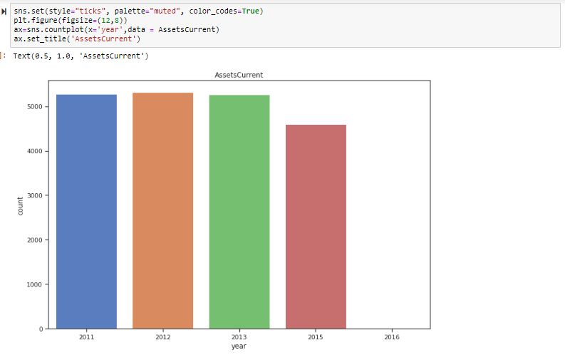
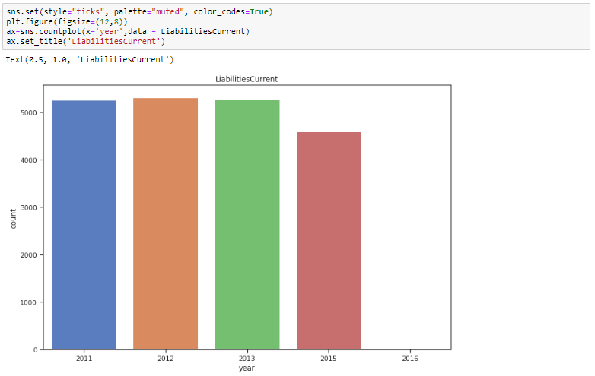
Key Statistical Features and Insights
Current Assets
Current Liabilities

Slide 8
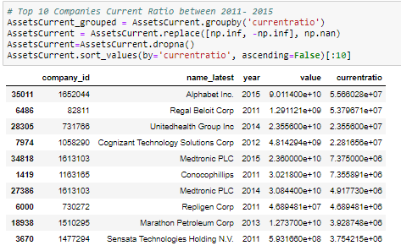
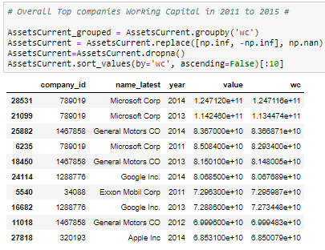
Top 10 Companies for Current Ratios and Working Capital from 2011 to 2015
Notes:
Rectangle has the highest current ratio

Slide 9
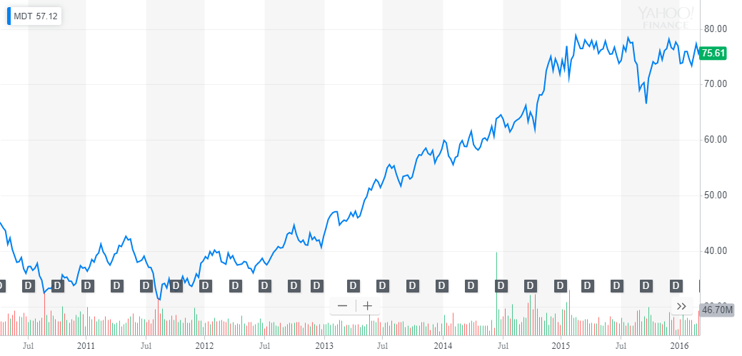
Medtronic PLC stocks from 2011 - 2015

Slide 10
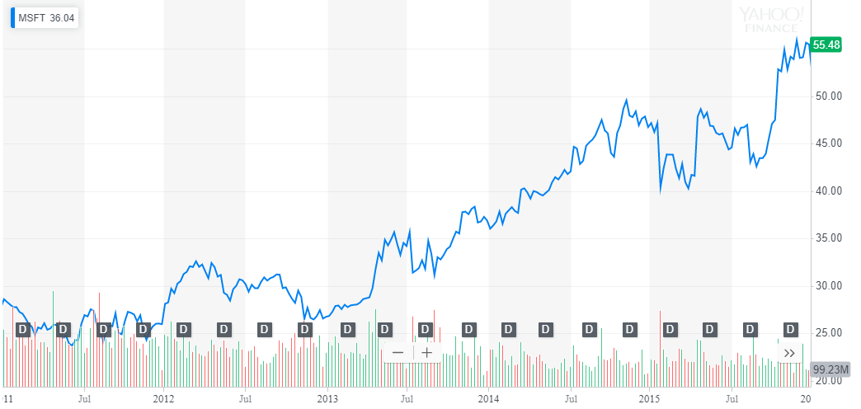
Microsoft Corp stocks from 2011 - 2015

Slide 11
Conclusion
Part A: The fastest growing sector from 2011 to 2015 was the Professional, Scientific and Technical Services sector with respect to Net Income Loss and Stockholder Equity.
The Top 5 companies driving the growth were
Groupon, Inc.
Digipath. Inc.
Neogenomics Inc
Sorrento Therapeutics, Inc.
Live Ventures Inc
Part B : We found the top 10 companies with respect to
Current Ratio - Which measures liquidity of a company, which in turn measures a company's ability to pay short-term obligations or those due within one year.
Working Capital - Which measures a company's efficiency and its short-term financial health.

